Slide 1
Fake News Detection Using MACHINE LEARNING

Slide 2
Final Year Design Project - I
Course Title : CSE 4000A
Sec : B
Submitted To:
Dr. Salekul Islam
Professor & Head of the Dept
Dept. Of CSE,
United International University
Supervised By:
Dr. Mohammad Nurul Huda
Professor & Director - MSCSE
Dept. Of CSE,
United International University

Slide 3
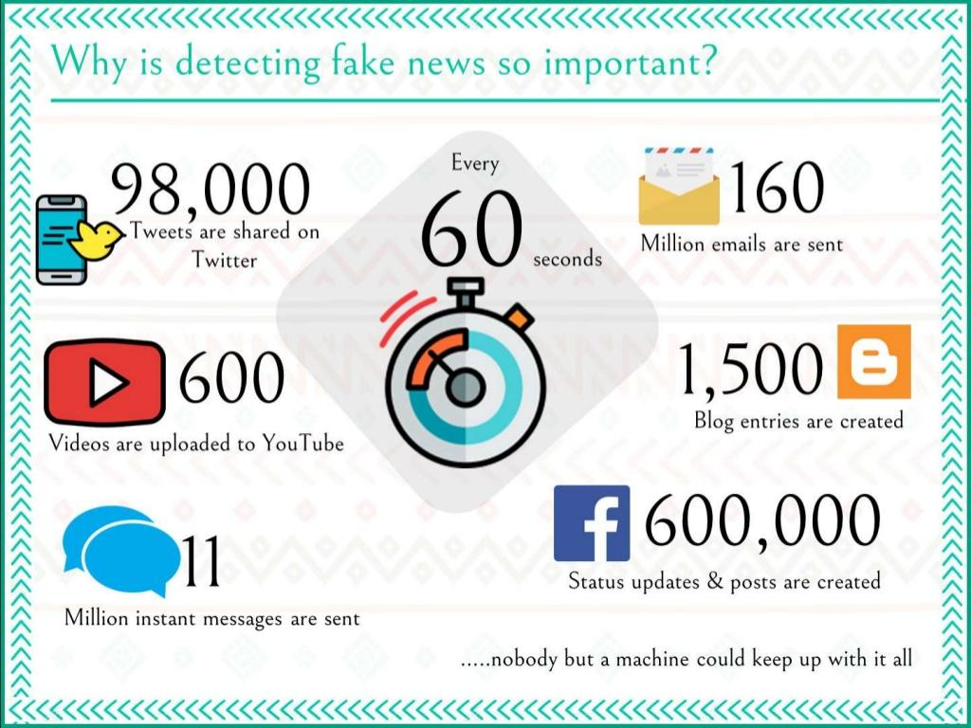
INTRODUCTION
Project Overview
Background of this problem
Where does the problem arise?
What will happen if the problem is not solved or it’s affect!

Slide 4

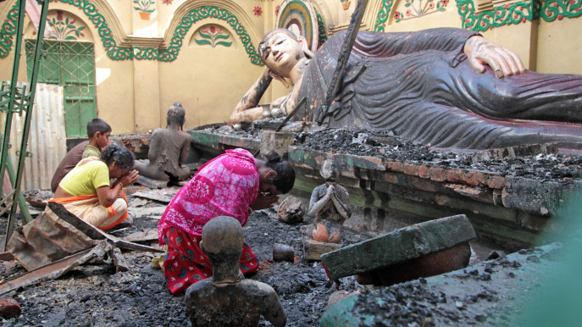
MOTIVATION
Why “Fake News” is challenging to control?
Which kind of people may get affected by Fake News?
How society can get violated by spreading Fake News?
Why solving this problem will benefit?
Ramu Tragedy 2012
Padma Bridge Rumor 2019

Slide 5
OBJECTIVES
The aim of this project is to provide a systematic evaluation of the machine learning algorithm for fake news prediction.
This can save time for people. Online news readers would be more benefited by using this project

Slide 6
Methodology
Preprocess & Label the data as “Real” or “Fake”.
Then test any news post collected from social media to find the output.
Curate data from different social media
Feed the dataset to the NLP based machine learning algorithms.
Bangla Text
Corpus
Pre-pro cessed
Dataset
SVM / MNB
Build Logical Model
New Text
Output

Slide 7
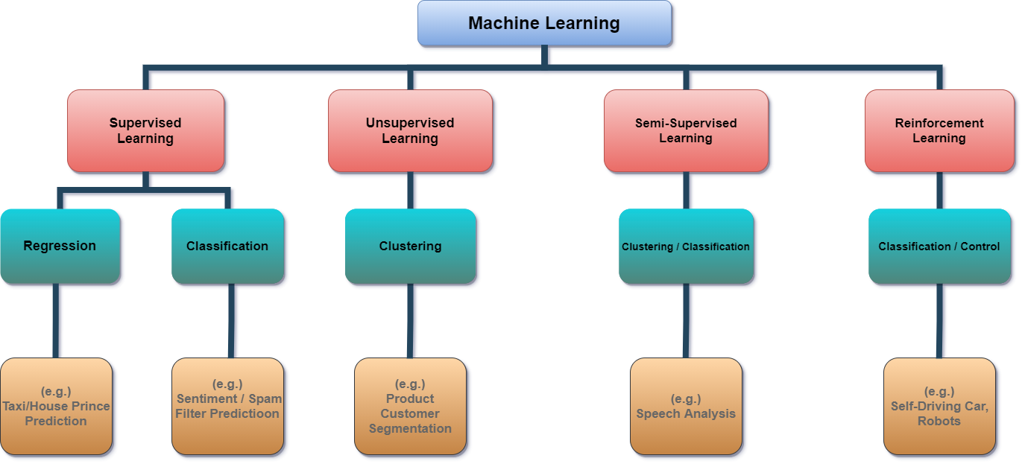
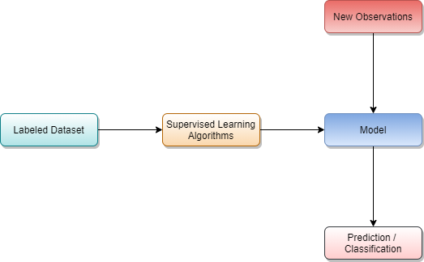
PRELIMINARIES
What is Machine Learning?
Supervised Learning.
Classification of Machine Learning

Slide 8
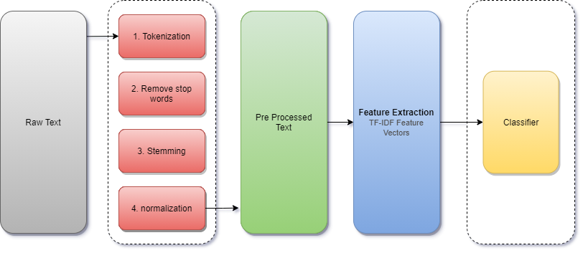
NLP
What is NLP?

Slide 9




Evaluation Methods
Accuracy
Precision
Recall
F1 Score

Slide 10
[1] Event Adversarial Neural Networks for Multi-Modal Fake News Detection
Literature Review
Dataset Used:
Type: Real-life
Source: Twitter, Weibo
Attributes: 10805(real),
12647(fake)
Algorithms Used:
Neural Networks : (RNN, CNN)
Evaluation Metrics Used:
Accuracy : Twitter-71.5%
Weibo-82.7%
LIMITATIONS & FUTURE WORKS :
according to “Wang, Yaqing and Ma, Fenglong and Jin, Zhiwei and Yuan, Ye and Xun, Guangxu and Jha, Kishlay and Su, Lu and Gao, Jing” at 2018, further future development can be done by using a using a larger dataset. Accuracy can be improved by implementing some hybrid-classifiers.

Slide 11
[2] Fake News Detection on Social Media A Data Mining Perspective
Literature Review
Dataset Used:
Type: Real-life
Source: “BuzzFeedNews”, “LIAR”, “BS Detector”, “CREDBANK”
Algorithms Used:
Machine Learning, Data Mining
Evaluation Metrics Used:
Precision, Recall , F1 Score, Accuracy, ROC and AUC curve
LIMITATIONS & FUTURE WORKS :
In this paper according to “Shu, Kai and Sliva, Amy and Wang, Suhang and Tang, Jiliang and Liu, Huan” at 2017 one of the major challenges for fake news detection is the fact that each feature has some limitations to directly predict fake news on its own. Obtaining a reliable fake news dataset is very time and labor-intensive.

Slide 12
[6] Detection of Bangla Fake News using MNB and SVM Classifier
Literature Review
Dataset Used:
Type: Real-life + Manually created news
Source: Online News Portal
Attributes: 1548(real),
993(fake)
Algorithms Used:
Machine Learning (MNB, SVM)
Evaluation Metrics Used:
Confusion Matrix
Precision : SVM-0.98, MNB-0.95
Recall : SVM-0.97, MNB-0.91
F1 : SVM-0.97, MNB-0.93
Accuracy : SVM-96.64%, MNB-93.32%
LIMITATIONS & FUTURE WORKS :
According to “Hussain, Md Gulzar and Hasan, Md Rashidul and Rahman, Mahmuda and Protim, Joy and Al Hasan, Sakib” at 2020, future work can be done using a larger dataset. A stemmer can be applied to minimize Dataset size and enhance model efficiency. Rate of success can be improved by utilizing hybrid-classifiers.

Slide 13
Literature Review
Comparison Table:
Ref No | Algorithms | Data Set | Accuracy | Limitations
[4] Eng | DL (RNN, CNN) | Twitter +Weibo 10805 (real), 12647(fake) | Twitter -71.5% Weibo - 82.7% | Can be improved by implementing some hybrid classifiers.
[5] Eng | Data Mining | BuzzFeedNews, LIAR, CREDBANK, BS Detector |  | Obtaining a reliable fake news dataset is very time and labor intensive
[6] Eng | Geometric Deep Learning | Twitter Size:1080 | 92.7% | Graph-based approaches require social network manipulations which is difficult
[7] Eng | NLP (BERT, Transformer) | CommonCrawl 5000 articles | 92% | Discriminator depends on leveraged distributional features rather than evidence

Slide 14
Literature Review
Comparison Table:
Ref No | Algorithms | Data Set | Accuracy | Limitations
[8] Eng | RNN | Twitter + Weibo 2845(real), 2811(fake) | Twitter - 89.2% Weibo - 95.4% | Model can be built that include concepts from crowdsourcing.
[9] Ban | SVM, MNB | Online news portal 1548(real), 993(fake) | SVM - 96.64% MNB - 93.32% | Various feature extraction technique and Hybrid classifier can be used.
[10] Eng | Linear SVM | 1627(Fake+Real) 240(Fake) | 78%

Slide 15
Gap Analysis
Language
Data Collection
Limitation

Slide 16
Project Requirements
Functional Requirements :
System Interface
Hardware Network Interface
User Interface
Communication Protocol

Slide 17
Project Requirements
Non-functional Requirements :
Accuracy
Ease of Use
Reliability / Information Security

Slide 18
Software Standards
Programming Language
Python
Version Controller
Github
Design Standard
UML
Project Management
JIRA
Markup Language
Latex
Data Formats
CSV
IDE
PyCharm
Google Colaboratory

Slide 19
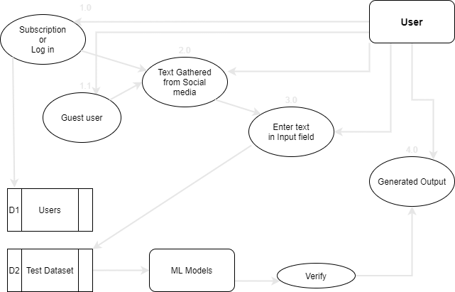
Data Flow

Slide 20
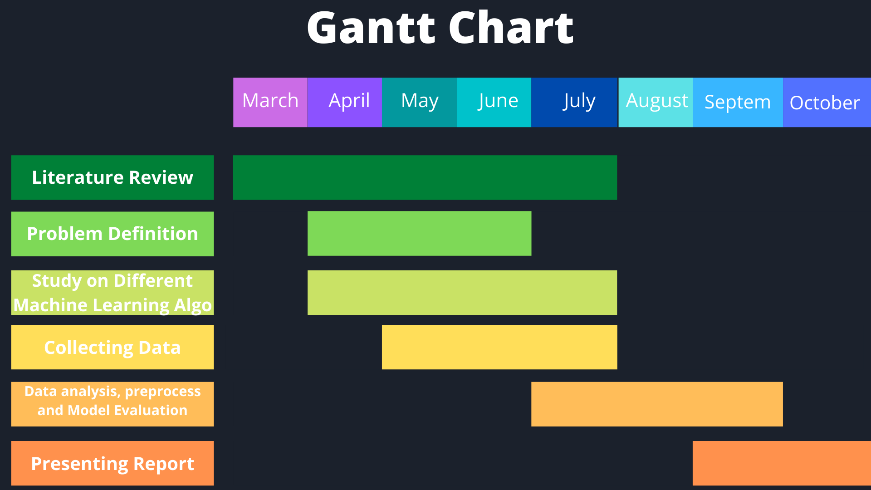
Project Management

Slide 21
Cost Analysis
Management
Deployment
Domain
> 10000 BDT/Year
Hosting
> 5000 BDT/Year
Virtual GPU
> 7000 BDT/Year
Project Management Tool
> 7000 BDT/Year
High End Desktop
> 120000 BDT

Slide 22
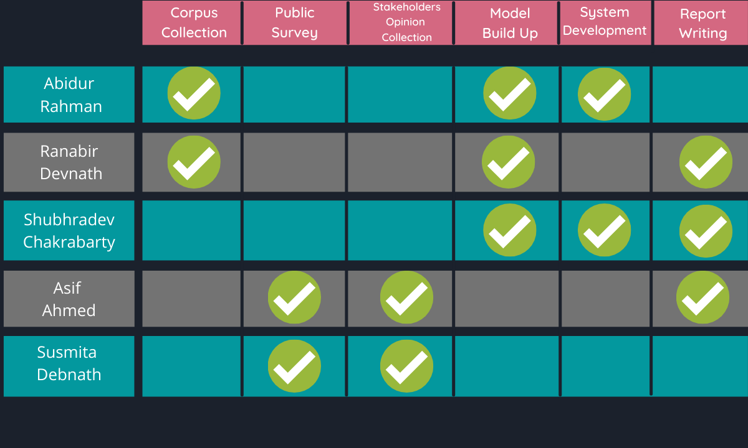
Task Allocation

Slide 23
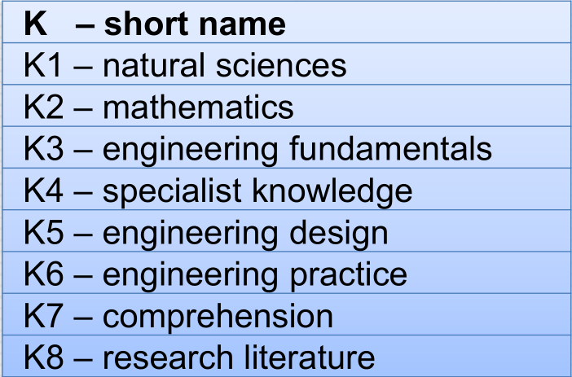
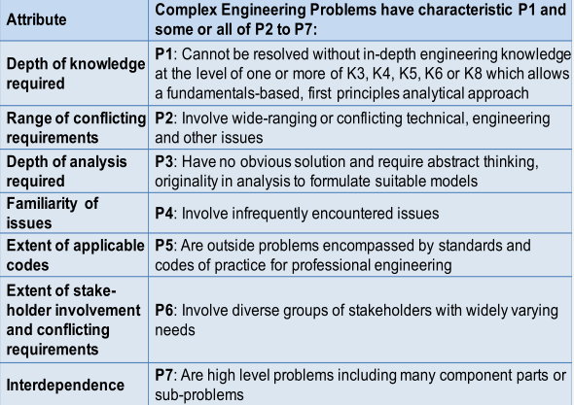
P’s that are addressed through this project
P1 : Depth of knowledge required
P2 : Range of conflicting requirements
P3 : Depth of analysis required
P4 : Familiarity of issues
P7 : Interdependence

Slide 24
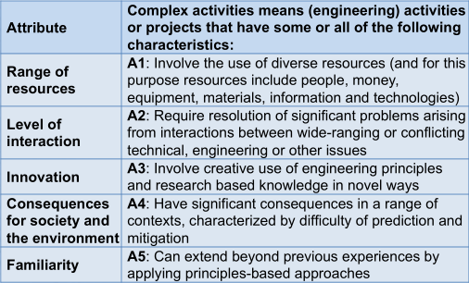
A’s that are addressed through this project
A1 : Range of resources
A2 : Level of interaction
A4 : Consequences for society and the environment
A5 : Familiarity

Slide 25
Thank You

Slide 26

Group Members
Susmita Debnath - 011 171 105
Asif Ahammed - 011 171 183
Abidur Rahman - 011 171 275
Ranabir Devnath - 011 171 288
Shubhradev Chakrabarty - 011 171 301

Slide 27
Contributions
Abidur Rahman
Ranabir Devnath
Shubhradev Chakrabarty
Asif Ahmed
Susmita Debnath

